Slide 1
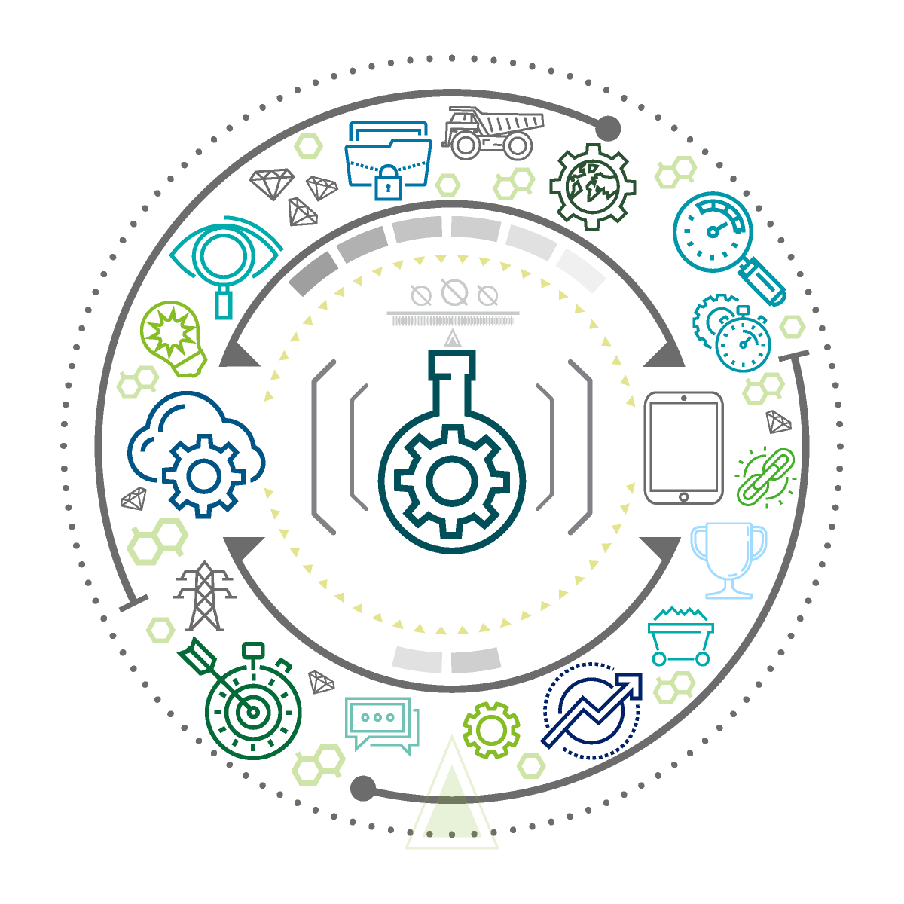
Assets For Managing Capital Projects
Jul 2023

Slide 2
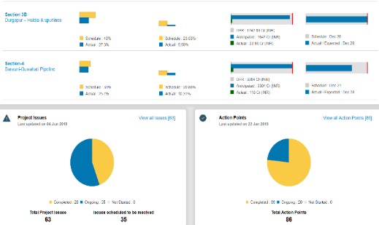
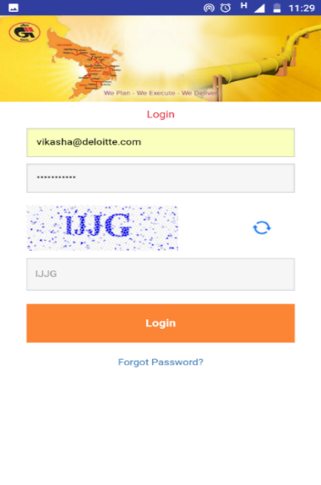
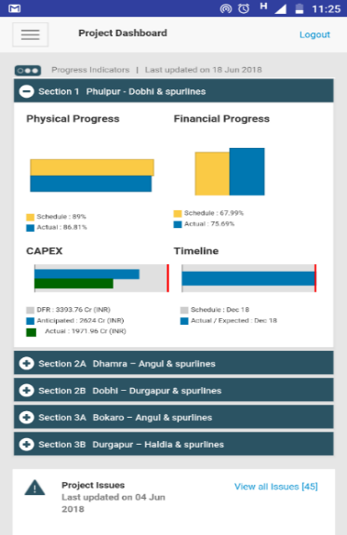
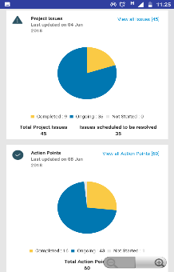
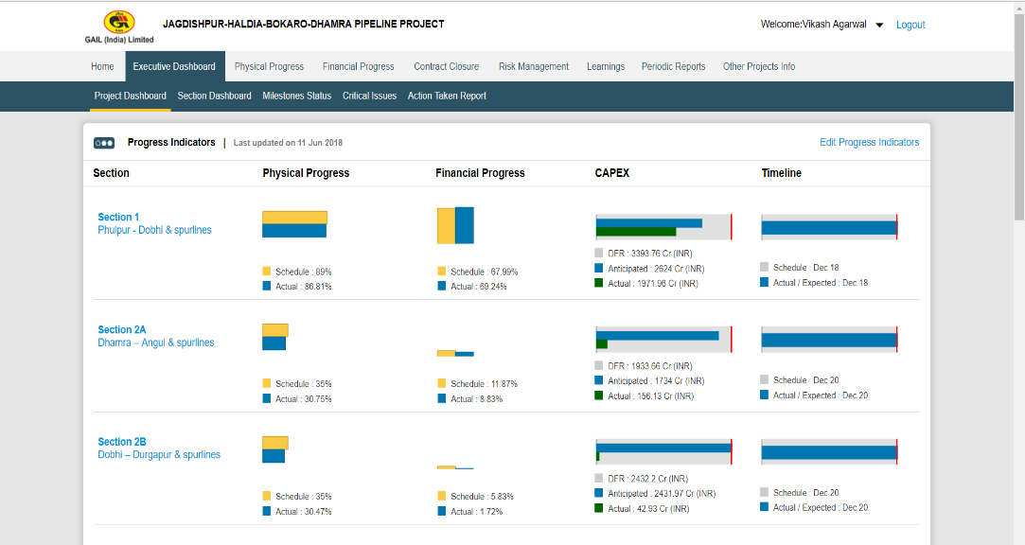
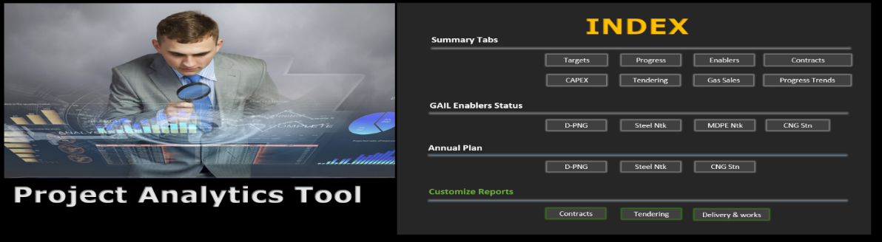
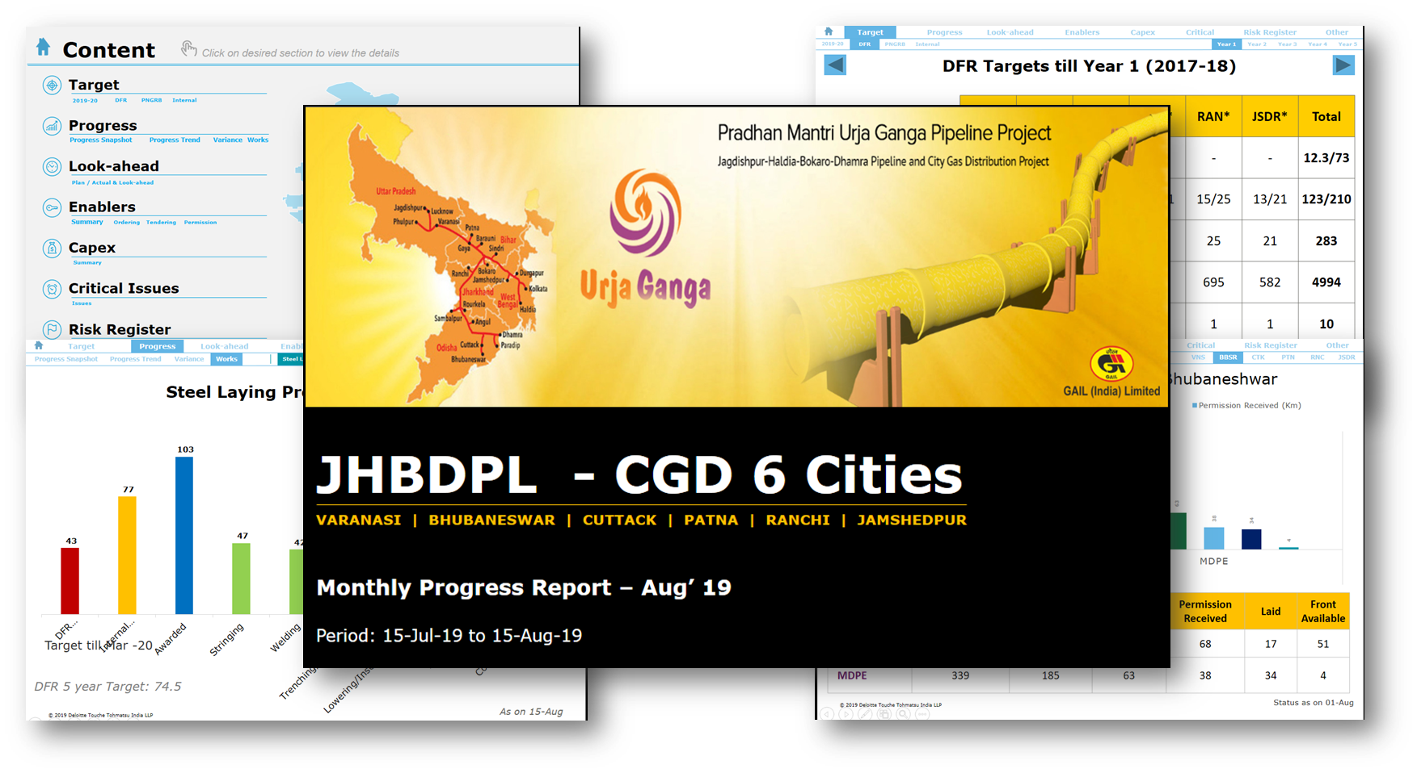
Development & Implementation of Customised Project Management Tools (1/3)
PMO Advisory for a large pipeline project for oil & gas company
Web based monitoring platform
Mobile based monitoring platform
BI Platform
Smart Reporting

Slide 3
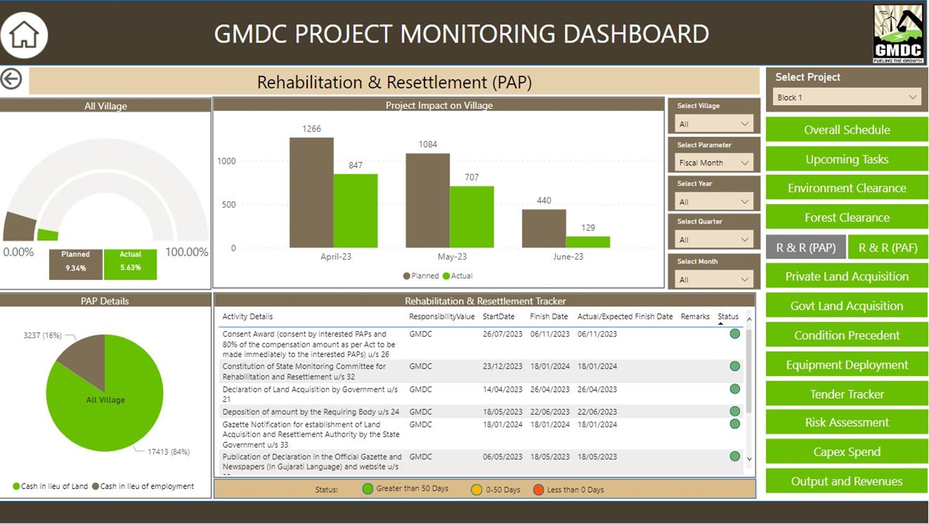
Development & Implementation of Customised Project Management Tools (2/3)
Customised Tool for Mining Projects

Slide 4
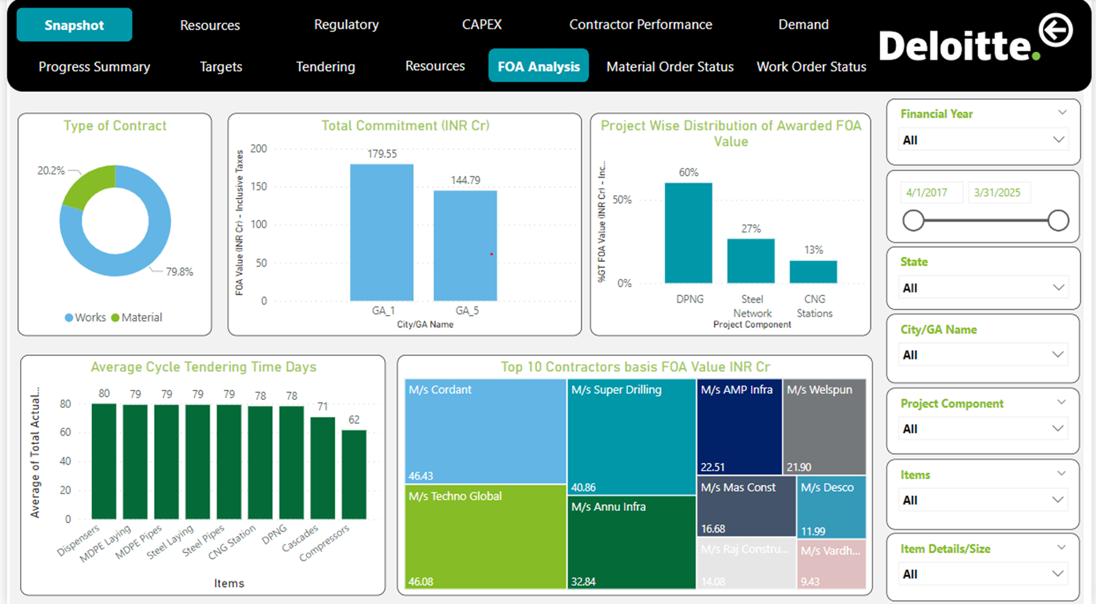
Development & Implementation of Customised Project Management Tools (3/3)
Digital Project Analytics Platform for City Gas Distribution Projects

Slide 5

END OF PRESENTATION
Deloitte refers to one or more of Deloitte Touche Tohmatsu Limited, a UK private company limited by guarantee (“DTTL”), its network of member firms, and their related entities. DTTL and each of its member firms are legally separate and independent entities. DTTL (also referred to as “Deloitte Global”) does not provide services to clients. Please see www.deloitte.com/about for a more detailed description of DTTL and its member firms.
This material has been prepared by Deloitte Touche Tohmatsu India LLP (“DTTILLP”), a member of Deloitte Touche Tohmatsu Limited, on a specific request from you and contains proprietary and confidential information. This material may contain information sourced from publicly available information or other third party sources. DTTILLP does not independently verify any such sources and is not responsible for any loss whatsoever caused due to reliance placed on information sourced from such sources. The information contained in this material is intended solely for you. Any disclosure, copying or further distribution of this material or its contents is strictly prohibited.
Nothing in this material creates any contractual relationship between DTTILLP and you. Any mutually binding legal obligations or rights may only be created between you and DTTILLP upon execution of a legally binding contract. By using this material and any information contained in it, the user accepts this entire notice and terms of use.
©2021 Deloitte Touche Tohmatsu India LLP. Member of Deloitte Touche Tohmatsu Limited

